Slide 1

Predicting Coupon Acceptance on E-commerce Platforms by -Aditya mane

Slide 2

Dataset Overview
317100
Data size
317100
Data Shape
12684 - rows
25 – columns
Data Types
Object (Categorical)
Integer, Float(Numerical)

Slide 3
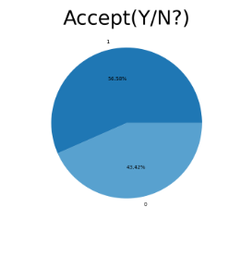
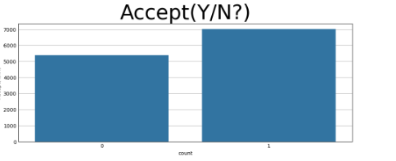
Target Variable
The target variable is (Accept(Y/N?))
The percentage of number of unique values in Target column
56.84% for accepting the coupon
43.15% for not accepting the coupon
The Target column is balanced

Slide 4
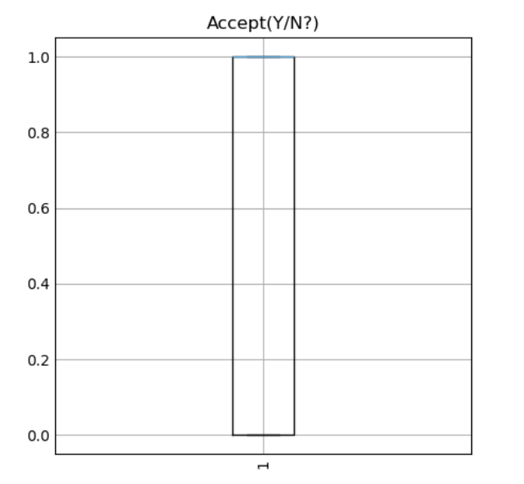
Data Preprocessing
Sorting Categorical and Numerical Columns in list
Sorting of numerical and categorical columns was done based on number of unique values
2. Duplicate & Missing Values
It has 291 duplicate values & in six columns has null values
After imputing missing values & handling duplicated values the result is
Zero missing values and Zero duplicate values
3. Outlier Treatment
In the dataset there was None outlier

Slide 5
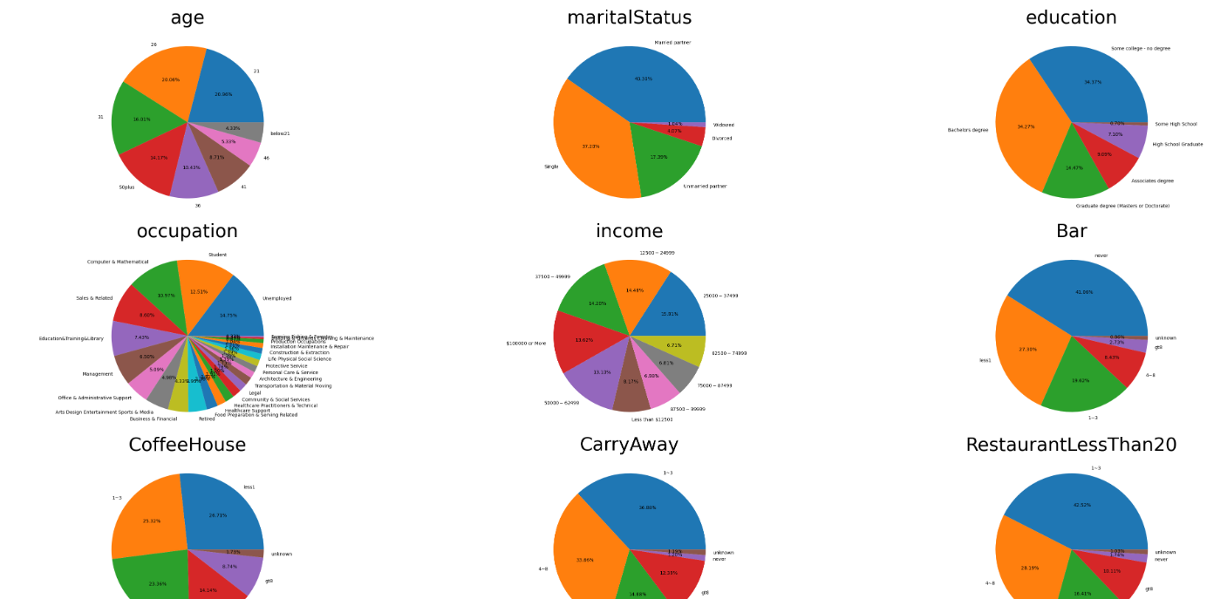
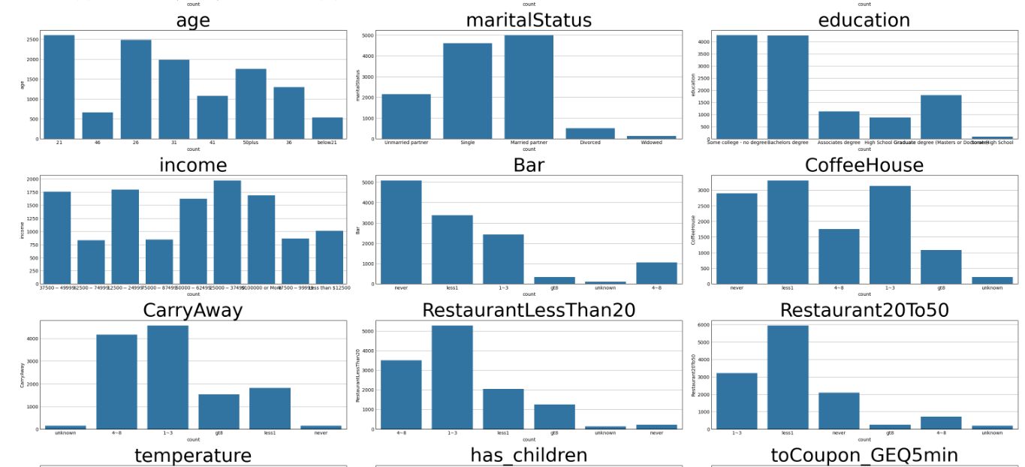
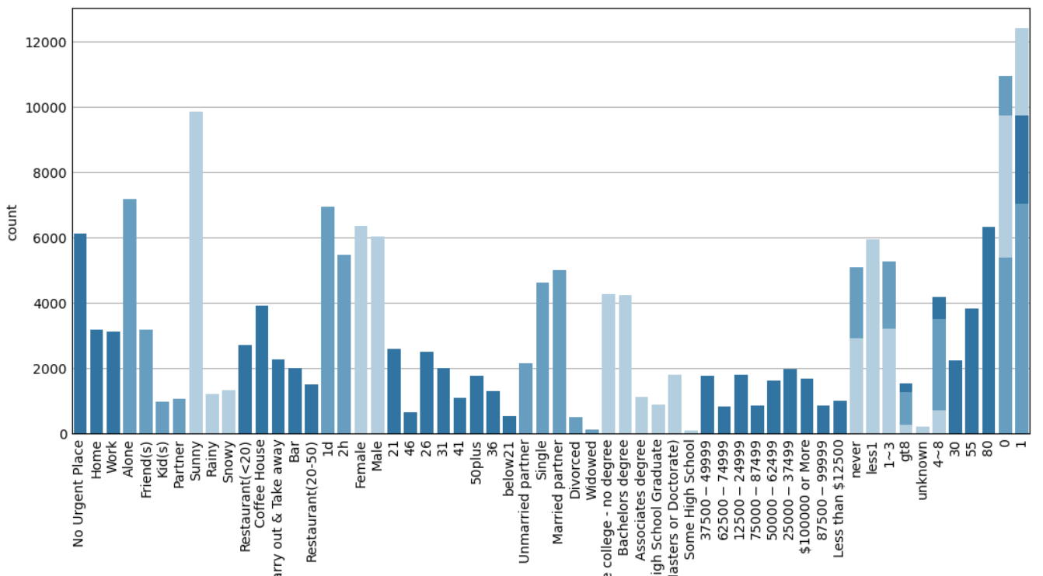
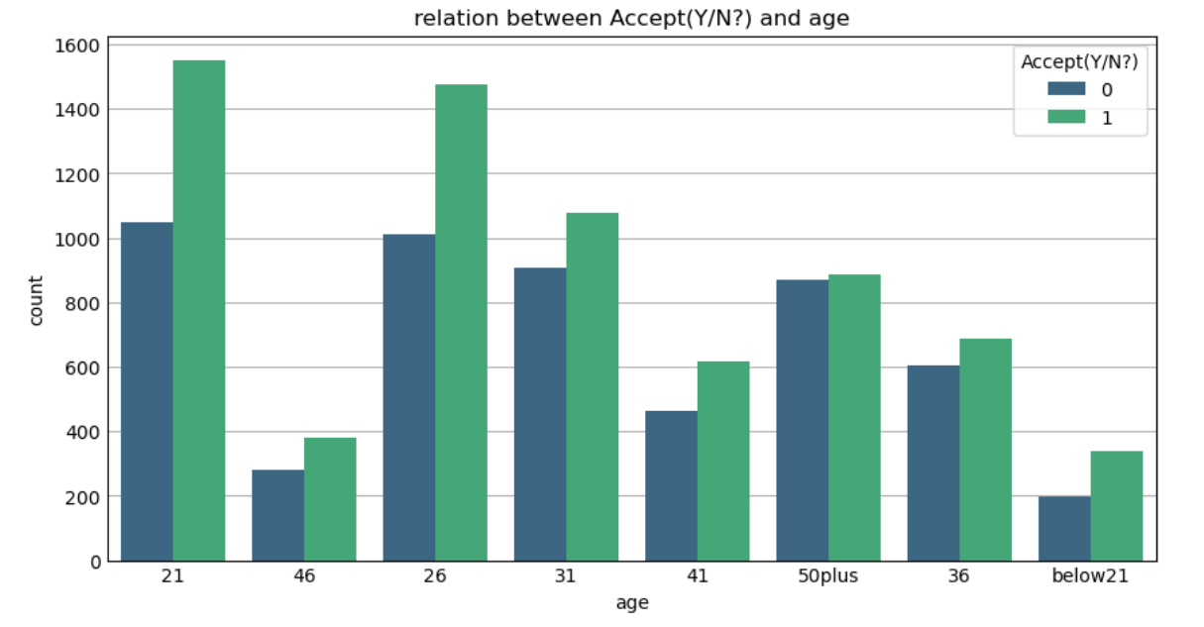
EDA- Categorical
Pie chart
Ensured segments were appropriately labeled and visually distinct for clarity.
Included percentage values to enhance understanding of relative contributions
Count plot
Utilized count plots to visualize the frequency distribution of categorical variables.
Stem plot
displays discrete values using vertical lines originating from a baseline.
Count plot with hue of target column
created count plot with the hue parameter to visualize the distribution of categories
across different target groups

Slide 6
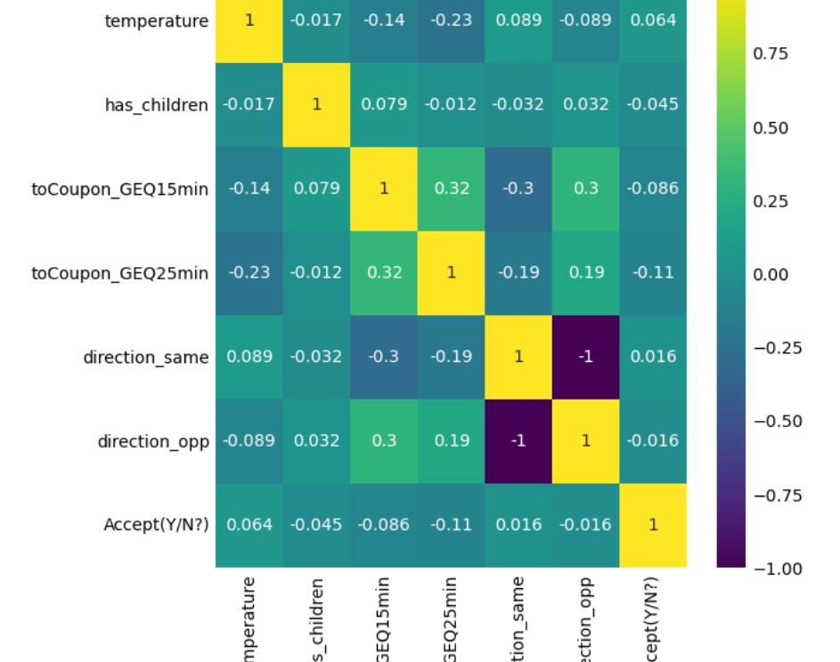
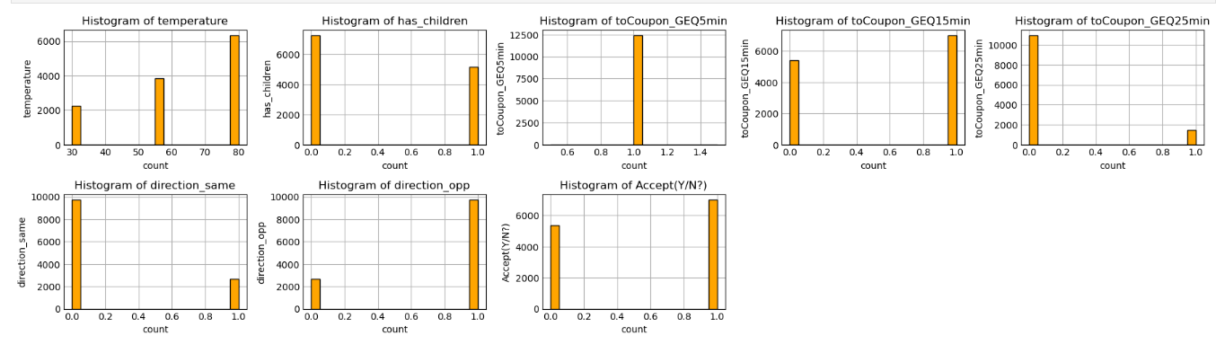
EDA - Numerical
Heatmap
We can see that very less multi-collinearity in numerical columns
Histogram
histograms to visualize the frequency distribution of numerical variables.

Slide 7
Label Encoding and Standardization
Label Encoding: Label Encoding was done
on Categorical columns
Standard-Scaling: Standard Scaling was done on Numerical columns after train test split to avoid data leakage

Slide 8
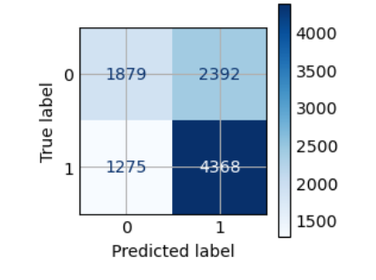
Model Building
train accuracy_score0.63011906029857,precision_score0.6461538461538462,recall_score0.7740563530037214
Logistic regression
logistic regression to predict binary or categorical outcomes based on input features.
Evaluated model accuracy using metrics like confusion matrix, train-test accuracy score, precision score, and recall score
Accuracy : train=0.63, test=0.62
Precision : train=0.64, test=0.62
Recall : train=0.77, test=0.78

Slide 9
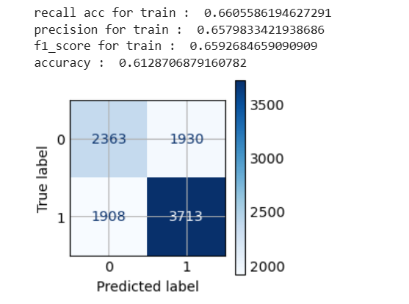
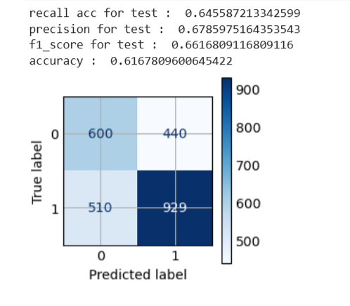
Model Building
Decision Tree
Built decision tree models to split data into decision-based segments for classification or regression tasks
Applied pruning techniques and set depth limits to reduce overfitting.
Enhanced model transparency by providing clear rules for predictions

Slide 10
Model Building
Random Forest
At each node, a random subset of features is considered for splitting, which helps in reducing overfitting and enhances model generalization.
It can be used for both classification and regression tasks
N- estimetor
Accuracy : train=0.76, test=0.70
Precision : train=0.73, test=0.68
Recall : train=0.90, test=0.87

Slide 11
Model Building
XGBoost Classifier
Boosted Decision Trees: Uses gradient boosting for strong predictive power.
High Performance: Optimized for speed and efficiency with parallel processing
Handles Missing Data: Automatically learns best splits without imputation.
Accuracy : train=0.91, test=0.74
Precision : train=0.90, test=0.74
Recall : train=0.94, test=0.81

Slide 12
Model Building
Adaboost Classifier
Boosting Algorithm: Combines weak classifiers to create a strong model
Sequential Learning: Each model corrects errors of the previous one
Weight Adjustment: More focus on misclassified samples in each iteration.
Accuracy : train=0.69, test=0.68
Precision : train=0.70, test=0.68
Recall : train=0.77, test=0.78

Slide 13
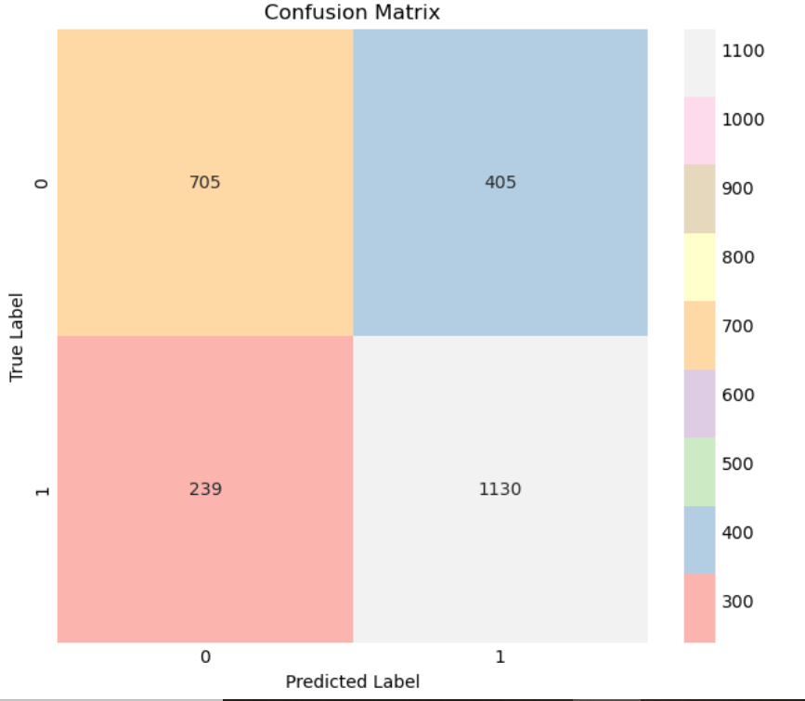
Model Building
Categorical Boosting
Optimized for Categorical Data: Handles categorical features natively without manual encoding
Gradient Boosting Algorithm: Based on decision trees with ordered boosting
No Need for One-Hot Encoding: Reduces memory usage and improves efficiency.
Handles Missing Values: Automatically processes missing data.
Accuracy : train=0.87, test=0.74
Precision : train=0.87, test=0.74
Recall : train=0.87, test=0.74

Slide 14
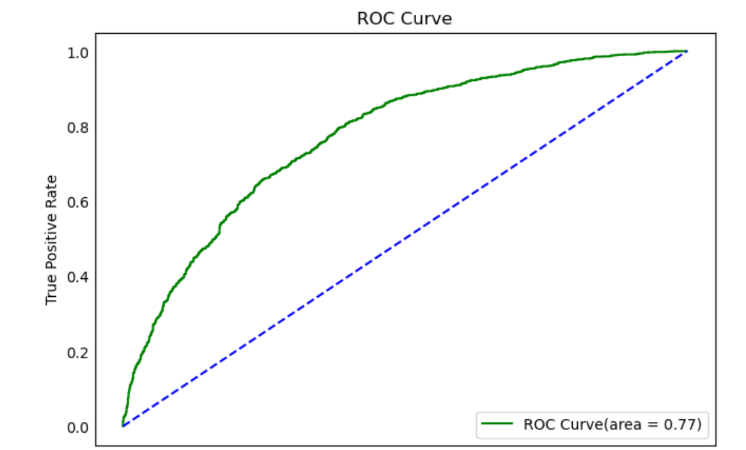
Final touch
ROC Curve
Receiver Operating Characteristic (ROC) Curve evaluates the performance of a classification model.
Plots True Positive Rate (TPR) vs. False Positive Rate (FPR) at various threshold values
AUC (Area Under the Curve) measures the model's ability to distinguish between classes (higher AUC = better model).
The roc curve perfectly place on TPR(True Possitive Ratio)

Slide 15


